Slide 1

WORKSHOP on
In-Situ Compressive Strength of
Concrete Structure by
Sigma Test & Research Centre
Delhi

Slide 2

Need for IN-PLACE Strength Testing During Construction
The Traditional Cube test measures the potential compressive strength of a given mix after 28 days , when the concrete under ideal laboratory conditions is compacted and cured in water at 27° Celsius.

Slide 3
Strength of Structure Depends
Transportation of concrete
Pumping
Casting
Compaction
Effective curing
Maturity developed on-site

Slide 4

In-Place Strength
Evaluation of in-place strength as per existing practice
Testing Methods | Limitations
Core drilling | Destructive Test, High Measurement Time.
Rebound hammer | High Uncertainty, Measures surface Hardness.
Ultrasonic Pulse Velocity Test | Qualitative Test, Low Coverage.

Slide 5
Objective
Pullout Test (ASTM C 900)
Pullout test of concrete determines the compressive strength of concrete as available at site taking into account all the variables outlined earlier for a direct comparison with the results of standards compression test as measured at the ready-mix plant under ideal laboratory conditions.

Slide 6
Pullout Test Method
18 mm diameter hole is drilled into the concrete up to 65mm depth.
With the help of special concrete router bit a 25mm diameter slot is made.
An expandable metal washer is placed in a hole and ring is expanded.
The expanded washer is then pulled out of the concrete using the pull out loading system.

Slide 7
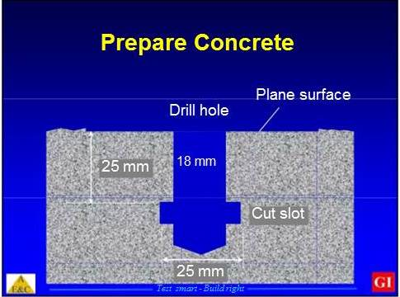


Slide 8
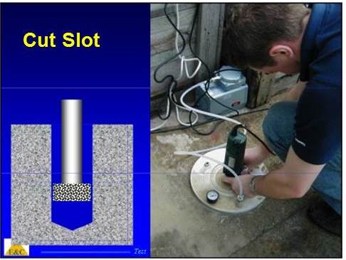


Slide 9
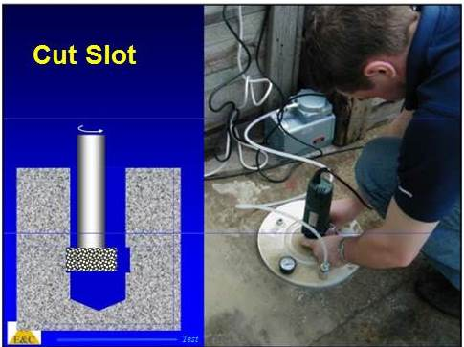


Slide 10
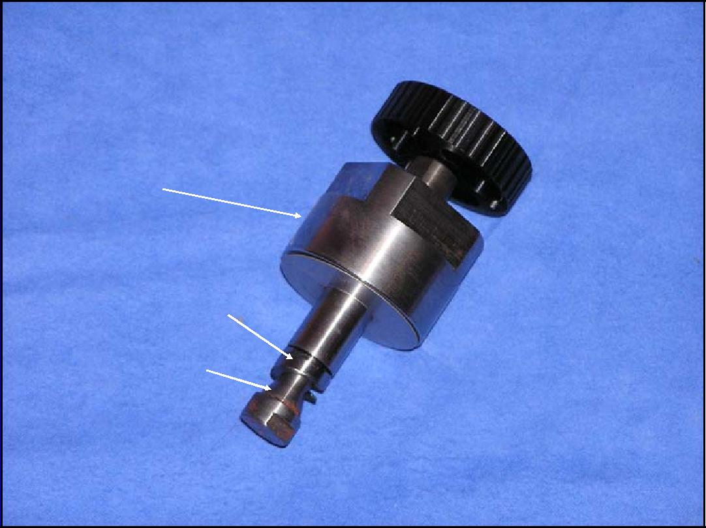

Ring Expansion Hardware
NUT
COILED RING
CONE

Slide 11
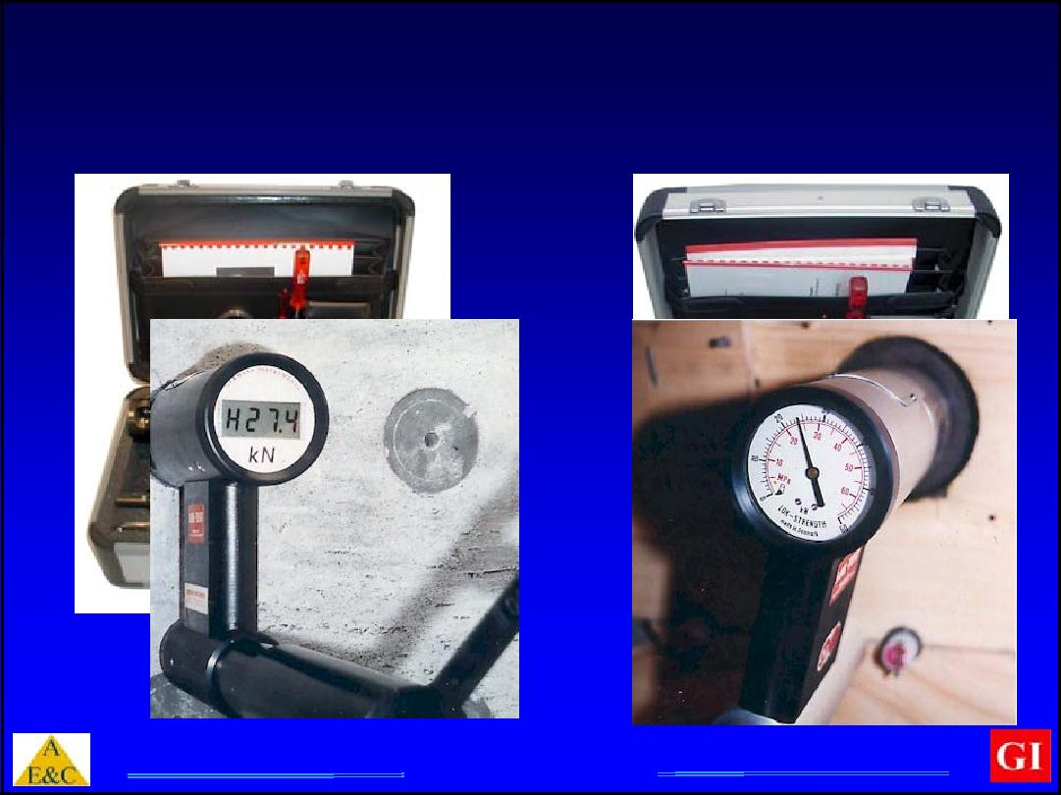

Commercial Test Systems

Slide 12
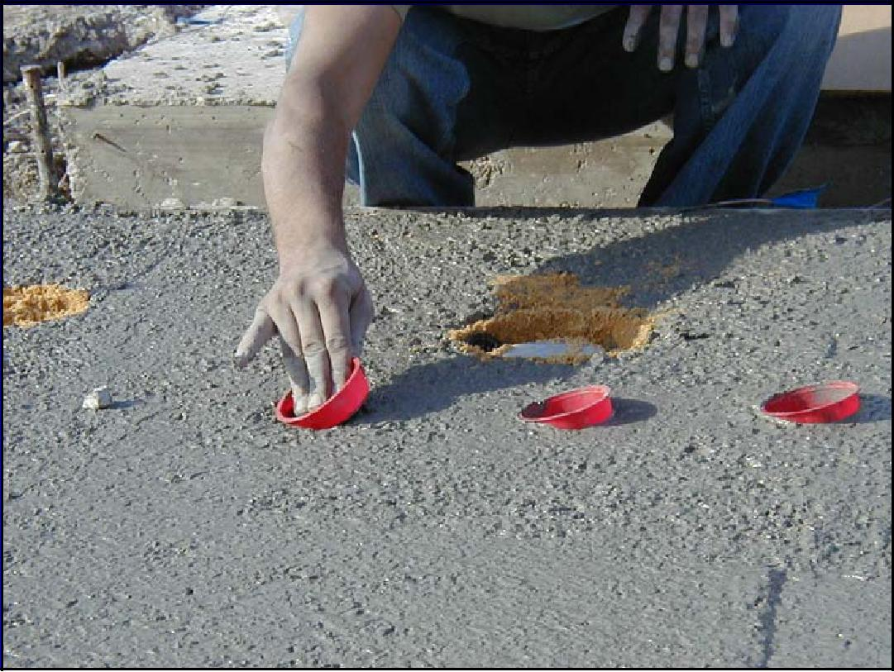


Slide 13
Recommended Number Of Tests
(as per ASTM C900)
For Slabs
5 Test points for every 465m² of the surface area.
For Columns and Beams
5 Test points for every 115m³ of concrete.
( Vol. of Col.: 300×450×3650 mm = 0.49 cubic meter )

Slide 14
Applications
To determine a minimum amount of curing needed in cold weather concreting.
For assessing existing structures.
For planning Rehabilitation, Restrengthning work
For estimating concrete strength during construction.

Slide 15
Correlation
Irrespective of failure theory, pullout strength is related to a fundamental strength parameter of concrete .
There is good correlation between pullout strength and compressive strength .

Slide 16
Robust Correlation
Not affected by:
Cementitious materials
Water-cement ratio
Age
Air entrainment
Admixtures
Shape or size of aggregate up to 40 mm

Slide 17
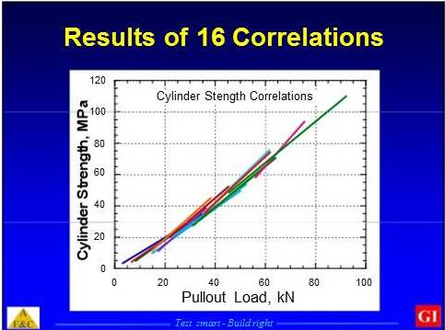

Slide 18
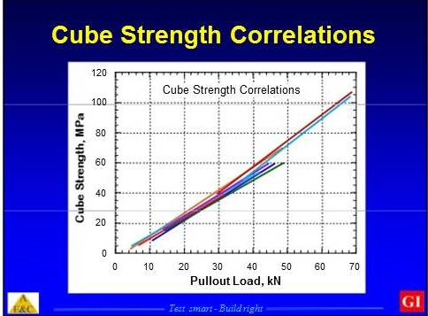

Slide 19
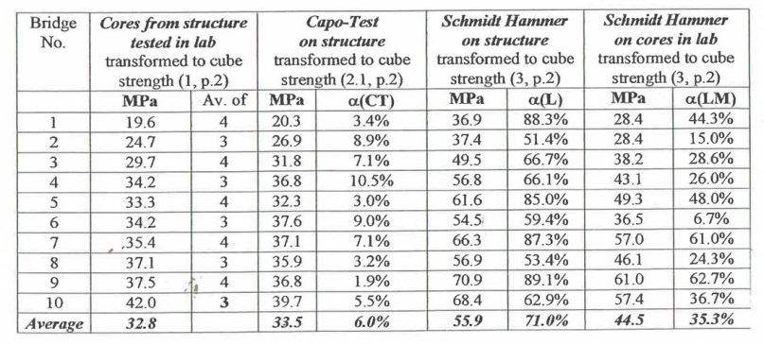
Comparison Between Compressive Strength Test From
Core , CAPO and Schmidt Hammer

Slide 20
Advantages
On the spot Results
High Accuracy , Repeatability
Consistent Results
Non Destructive
Helps in Localizing problem

Slide 21
Advantages
“Speed of the overall construction programme can be
Increased if an accurate assessment of the early-age in – situ strength is made because this allows a much faster turn around”.
Dept. of Civil Engineers
The University of Liverpool

Slide 22
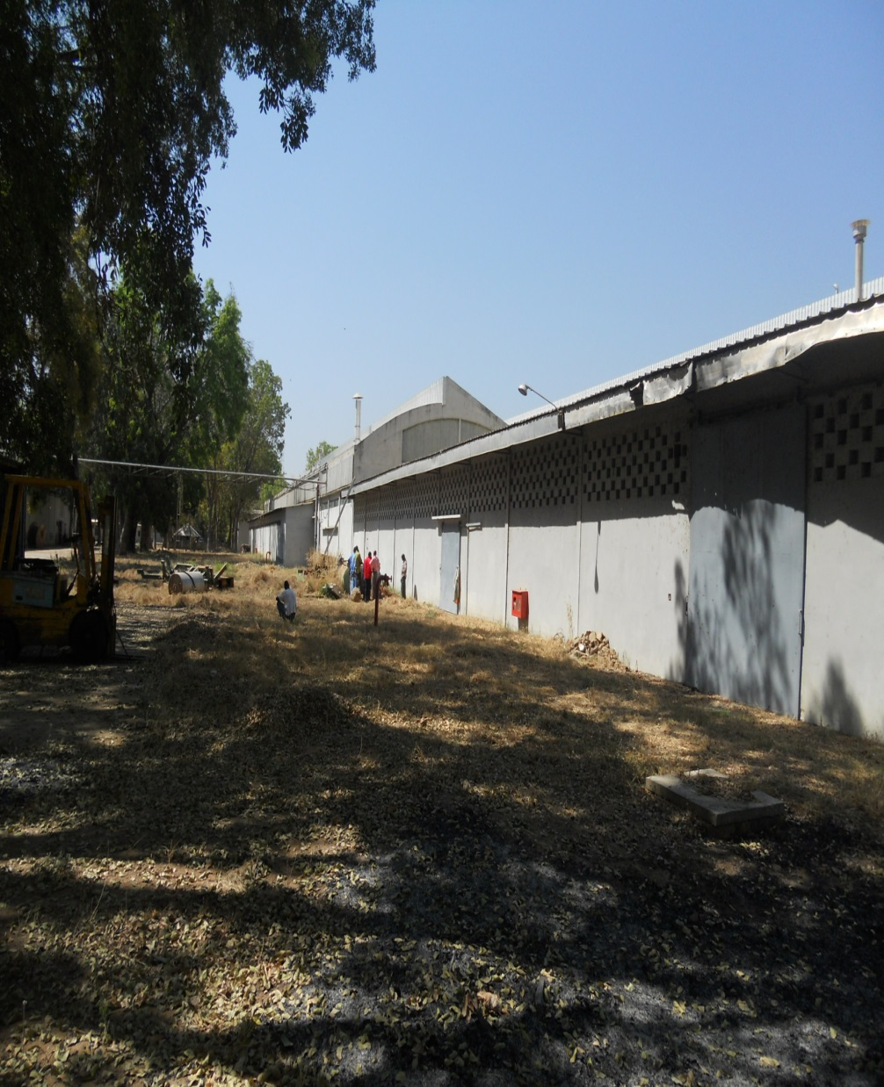
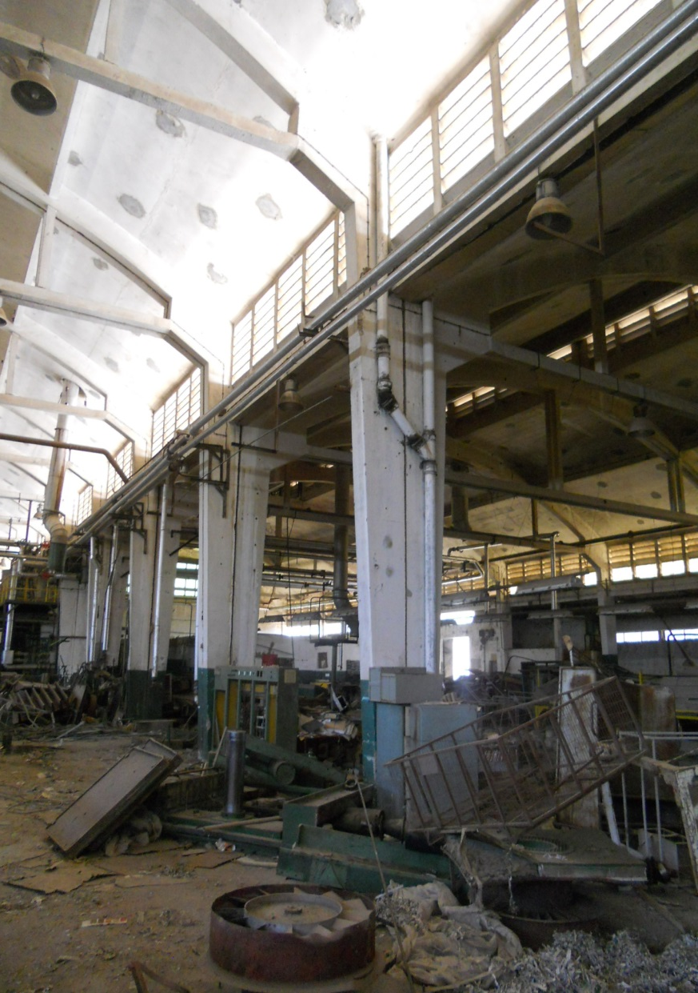
CASE STUDIES
Min of Textile , Government of Chad , Africa

Slide 23
CASE STUDIES
Samsung India - Sec 102, Noida
700000 Sq. ft. Area
Times of India - Gurgaon
Luxor of International - Noida
Sri Sri Ayurveda - Kotdwar , Uttaranchal

Slide 24
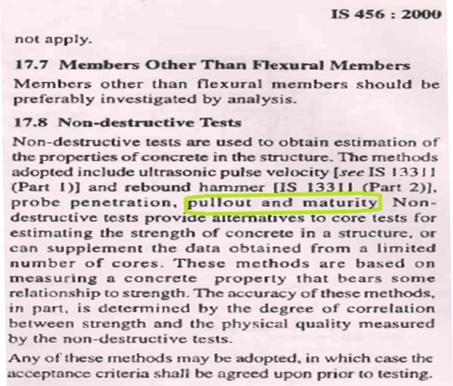
IS Reference

Slide 25


